Slide 1
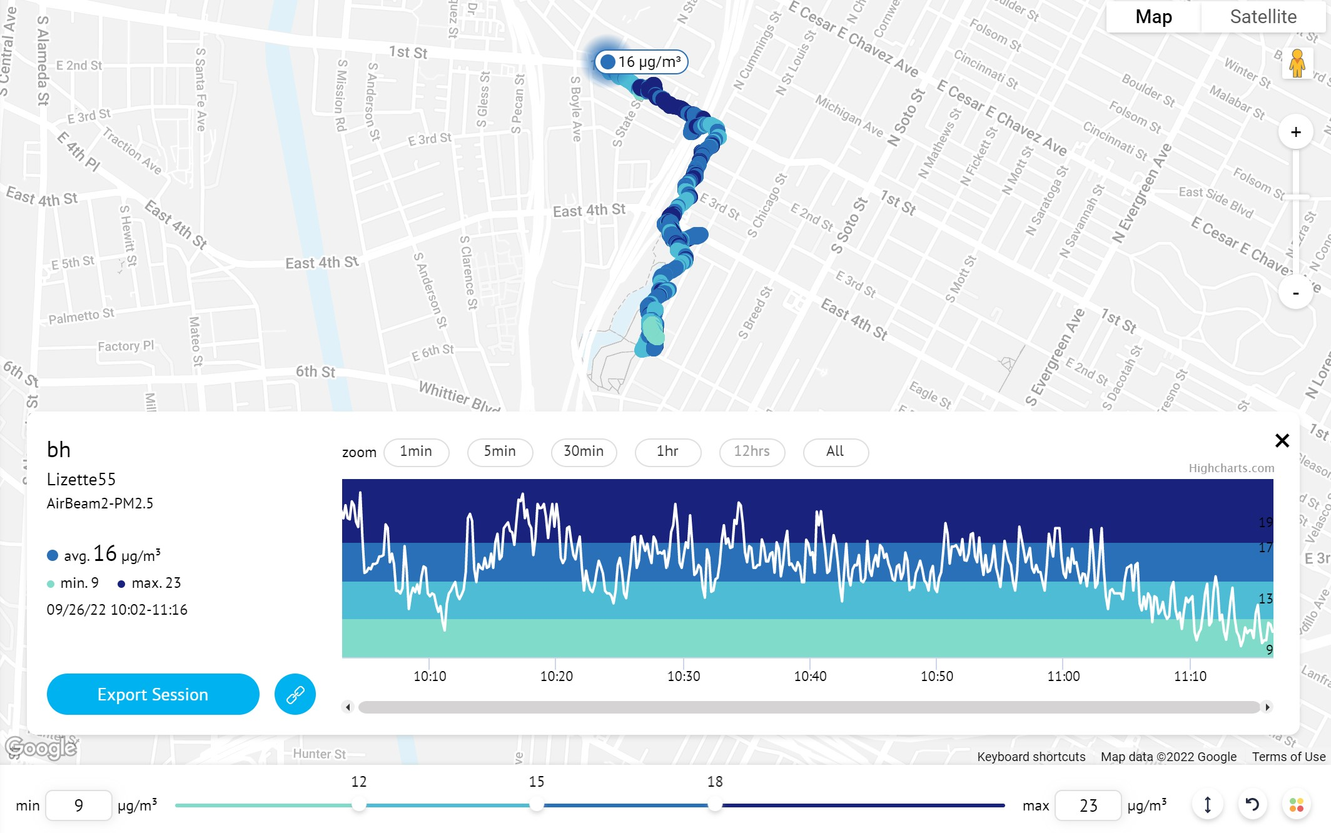
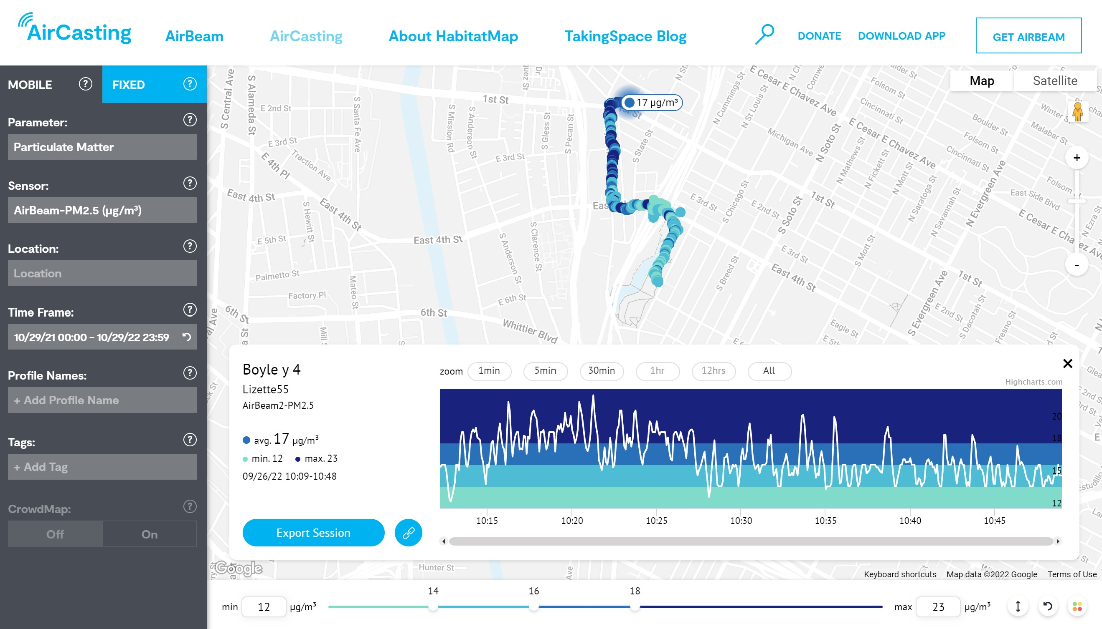
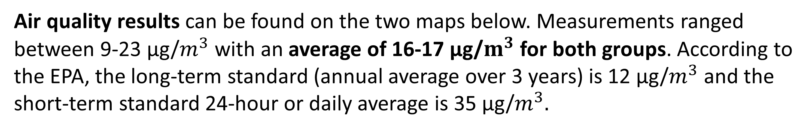




Results of a Participatory Science Pilot in Boyle Heights
By: Lizette Romano, MPH Environmental Health Candidate at UCLA Fielding School of Public Health
Climate Justice Fellow from May - December 2022 at Climate Resolve
GOALS:
Promesa Boyle Heights is advocating for more green spaces in the community, so we (Climate Resolve) partnered with them on a pilot to measure air quality, surface and thermal temperatures, and sound levels. We wanted to compare measures near green spaces to those in other areas. Some areas in Boyle Heights are in the 90-100th percentile for Diesel PM and PM2.5 according to CalEnviro4.0, both of which affect air quality.
Air quality results can be found on the two maps below. Measurements ranged between 9-23 µg/$m^{3}$ with an average of 16-17 µg/$m^{3}$ for both groups. According to the EPA, the long-term standard (annual average over 3 years) is 12 µg/$m^{3}$ and the short-term standard 24-hour or daily average is 35 µg/$m^{3}.$
RECOMMENDATIONS:
After the activity, we asked how much the groups felt they knew before and after about the topics we discussed. We found that the % that knew a little before the activity decreased and there was an increase in the % that reported knowing a lot after the activity. The activity was effective in increasing knowledge and could be replicated in communities looking to raise awareness of environmental issues with data.
Walks can be done at different times, for example commute hours (8-9am) or focused on specific measures that groups may want to collect. Ongoing walks would be useful to collect more data points and help strengthen conclusions.
Using the pilot experience and feedback from Promesa’s Lideres, I revised the participatory science activity template. The template outlines steps to plan a walk, materials, health thresholds, recommended facilitator prompts, and resources (i.e., survey templates). These materials were made for Climate Resolve’s use.
ADDITIONAL DATA & RESOURCES:
Link to raw data and google document summarizing information: http://bit.ly/3ibCbHh
Air Data for Group 1: Boyle & Cummings Street
Air data from data collection “observer” sheets:
The highest measurement taken was 22 µg/$m^{3}$ when there was more traffic and sounds coming from cars on the freeway and no wind could be felt. The lowest measurement was 16 µg/$m^{3}$ when the group was passing by a bus and no wind could be felt. Overall, measurements were lower when there was less car traffic.
The AirBeam sensor tracked 23 µg/$m^{3}$ as the highest PM2.5 measurement and 9 µg/$m^{3}$ as the lowest. The lowest point occurred when the group was in the park.
METHOD & RESULTS:
A community walk took place from 10am-11am on a sunny day with temperatures ranging from 80-93°F. Community members were trained on how to use air quality sensors, NIOSH sound level meter app, thermal cameras, temperature guns, and were asked to write down observational data. Two routes were selected with 5 stops each for data collection points. Groups rejoined at a central end point of Hollenbeck Park about a ½ mile away.
Findings for route/group 1: Boyle & Cummings Street
The highest sound level lasted about 10 seconds and was 90 dbA, it occurred when there was a lot of traffic about 10 feet away. In total there were 5 points where dbA was over 85. Sound levels above 85dbA could harm hearing if they occur regularly (average of 8 hours a day) according to CDC.
The highest thermal temperature taken was 58.3°C (136.94 °F) of a brick wall exposed to the sun. The highest surface temperature taken was 102°F on pavement at a gas station. The lowest thermal and surface temperatures were taken under the freeway bridge (shaded areas).
Findings for route/group 2: Boyle & 4th Street
There was no sound level recorded by the group above 85 dbA. The hottest thermal temperature taken (based on colors) was of playground equipment though cooler colors could be seen in the shade. Children using playground equipment may be more susceptible to burns.
The highest surface temperature taken was 116°F on the pavement next to a car in the sun. Temperatures on surfaces like asphalt heat up even more than the air temperature.
Air Data for Group 2: Boyle & 4th Street
Air data from data collection “observer” sheets:
The highest measurement taken was 20 µg/$m^{3}$ on 4th St & Freeway. There was no wind and buses were present too. The lowest measurement was 15 µg/$m^{3}$ when the group was passing by a car(s).
The AirBeam sensor tracked 23 µg/$m^{3}$ as the highest PM2.5 measurement and 12 µg/$m^{3}$ as the lowest.
Post-Survey Feedback & Future directions
ACKNOWLEDGMENTS
Climate Resolve supervisors: Catherine Baltazar & Chase Engelhardt.
Special thanks to our pilot group from Promesa Boyle Heights: Itzel Flores Castillo Wang, Francisco Romero, and Lideres.
CONCLUSION: The data we collected during the walk showed that air quality improved in parks and near less car traffic. Vehicle traffic produced more noise for the groups as they walked. Unshaded surfaces and objects were more susceptible to heating up.

