Slide 1
Notes:
BEGINNING:
At some point in our lives, many of us will experience a feeling of doom. Doom over the end of an era in our lives or a project that we couldn't complete. according to Merriam Webster's dictionary definition,
Doom is an unhappy destiny

Slide 2
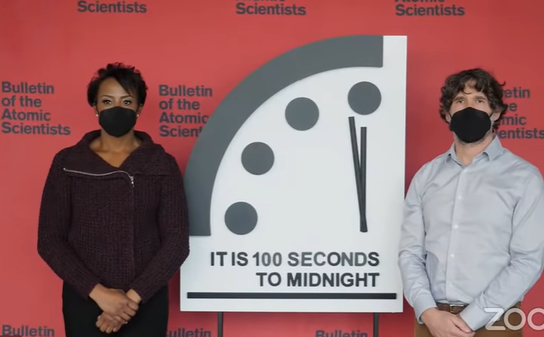

Notes:
For some, this feeling will be channeled into a clock: [Show slides of doomsday clock TIME 12 seconds of voice over]. The doomsday clock gives an overwhelming feeling of doom since it's always so close to being near the end.

Slide 3
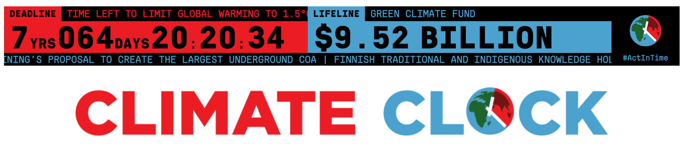
Notes:
For others, we will channel the feeling into specific topics like climate. [Show climate clock: (https://climatedoomsdayclock.info/?temp=2)]. This clock shows us how much longer we have to get our CO2 emissions down before our temperature warms drastically.

Slide 4
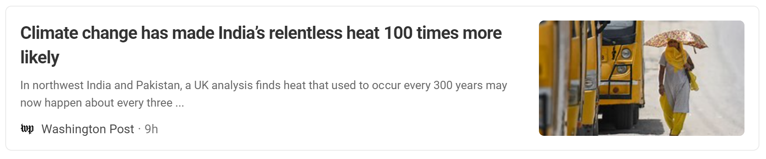
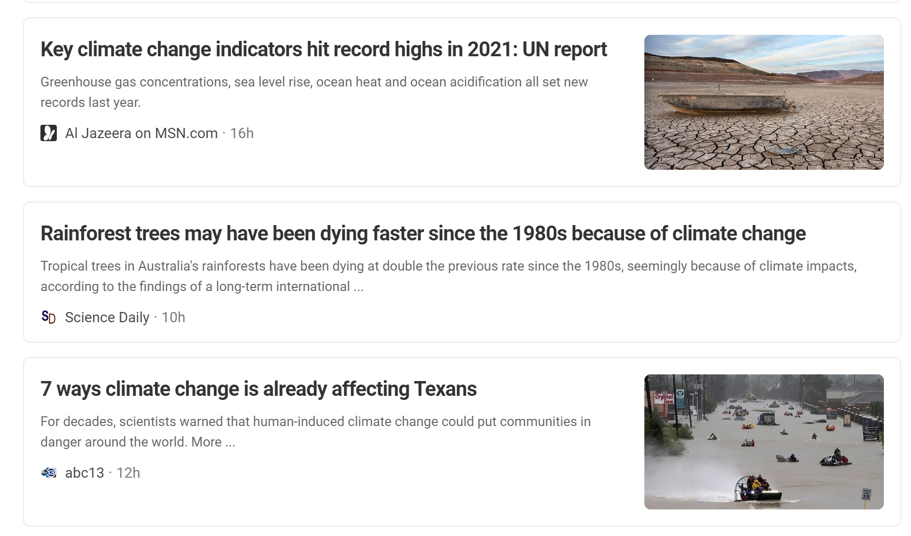
Notes:
We see doom in media stories left and right. [read titles one by one] Climate change has made India's relentless heat 100 times more likely. 7 ways climate change is already affecting Texans. Key climate change indicators hit record highs in 2021.

Slide 5
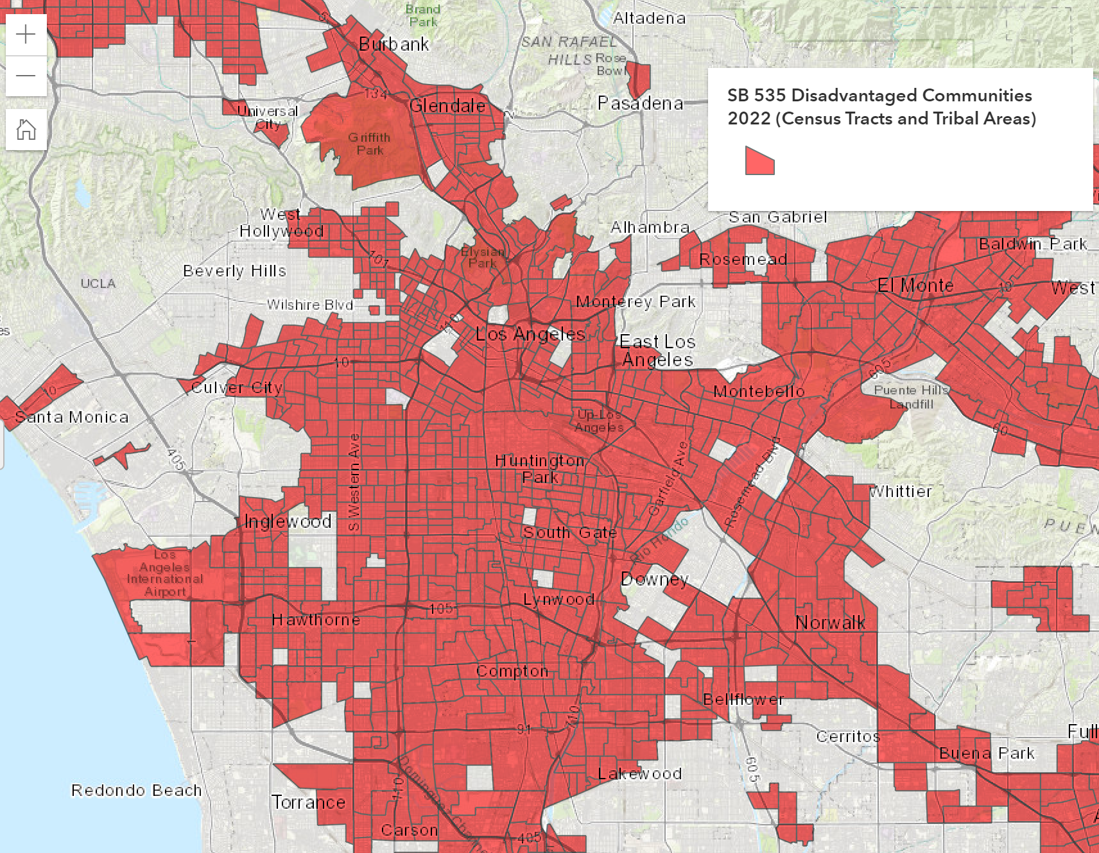
Notes:
We see new maps telling us just how badly climate change is in our communities and surrounding areas. These stories are examples of climate doomism.

Slide 6
Climate doomism
Notes:
Climate doomism is the idea that we are past the point of being able to save our planet due to our actions and inaction.

Slide 7
Notes:
Some of the consequences of climate doomism is that it can be a scare tactic to keep people in a state of doom.
It is perpetuated when climate information is made inaccessible through language and cultural barriers.
It is also used by wealthy nations blaming developing countries for not doing things correctly (economically sustainable) when the wealthy have often been those exploiting resources of others. As a result of climate doomism, we might experience anxiety and constant worry about our planet coming to an end. Or, depression and hopelessness in our own existence. We might experience other mental health issues as we're bombarded with a narrative of climate doom.

Slide 8
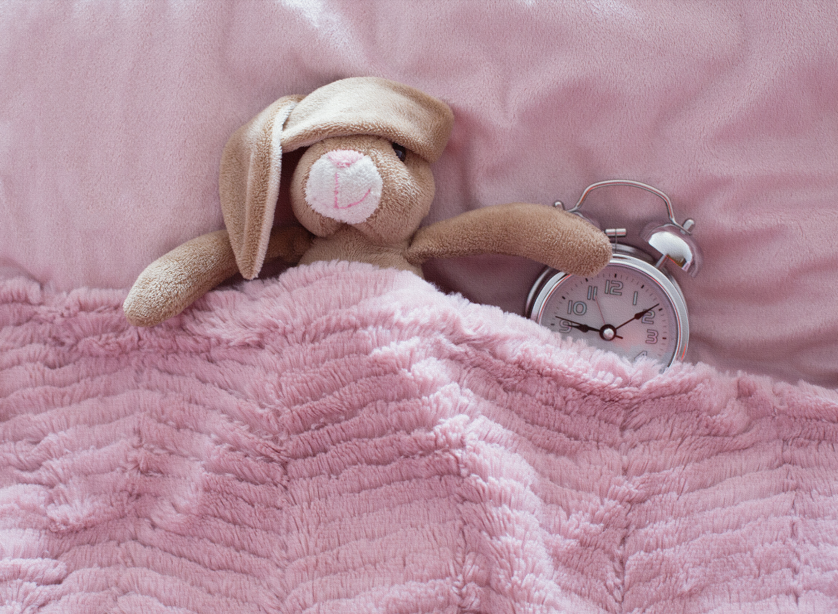
Notes:
What if we paused for one moment? Let's take a break from the doom of the clocks and time.

Slide 9
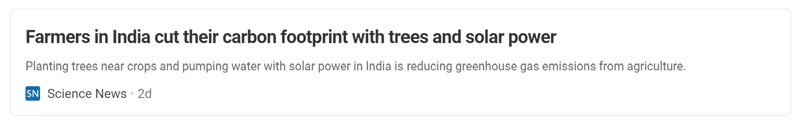
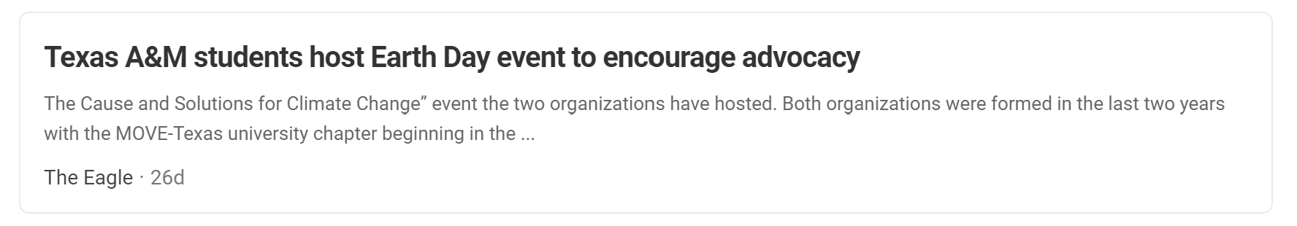
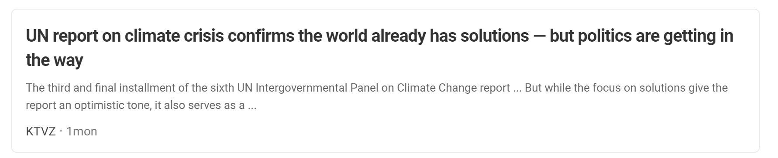
Notes:
For every climate doom story, we could likely find one positive story from the same area. [read titles] Farmers in India cut their carbon footprint with trees and solar power. Texas students host Earth Day event to encourage advocacy. UN report on climate crisis confirms the world already has solutions. This last one has a note that politics are getting in the way. It tells us that all we have to do is get past this barrier but the solutions are there.

Slide 10
Notes:
Advocacy organizations have known this too. Communities in the front lines can often see a different story than what the media sells.

Slide 11
“Reports and research studies call our communities “disadvantaged” but we denounce that and instead, shine through challenges and push our own empowered narratives. ”
- East Yard Communities for Environmental Justice
Notes:
[read quote]:
“Reports and research studies call our communities “disadvantaged” but we denounce that and instead, shine through challenges and push our own empowered narratives.” This is a quote from a local nonprofit doing environmental justice work. Environmental justice is a movement that hopes to bring healthy environments to communities carrying disproportionate burdens of pollution.

Slide 12
Find your role.
Notes:
We have the solutions, it's up to each of us to find our role in this challenge and bring a new outlook to how the story is portrayed.

Slide 13
Notes:
CONCLUSION:
When we see or read the news, we should ask ourselves through what lens the author is viewing the world. For years, we've heard that climate change will wipe out the human species and that our time is running out. Climate doomism leaves us feeling empty and hopeless on doing anything differently since we're already doomed. It's important that we highlight the voices of communities that are already acting on solutions. Let's fight the narrative of doom with one of action. We know what to do, we just need to act.

Slide 14
Sources:
https://queerbrownvegan.com/what-is-climate-doomism/
http://ph.lacounty.gov/eh/climatechange/index.htm
http://eycej.org/
https://experience.arcgis.com/experience/1c21c53da8de48f1b946f3402fbae55c/page/SB-535-Disadvantaged-Communities/
https://climateclock.world/news
https://thebulletin.org/doomsday-clock/

