Slide 1

HSC 420: Global Health
Yesenia Basulto, Paola Gutierrez, Lizette Romano, Misty Ruiz, and Michelle Weinberger

Slide 2
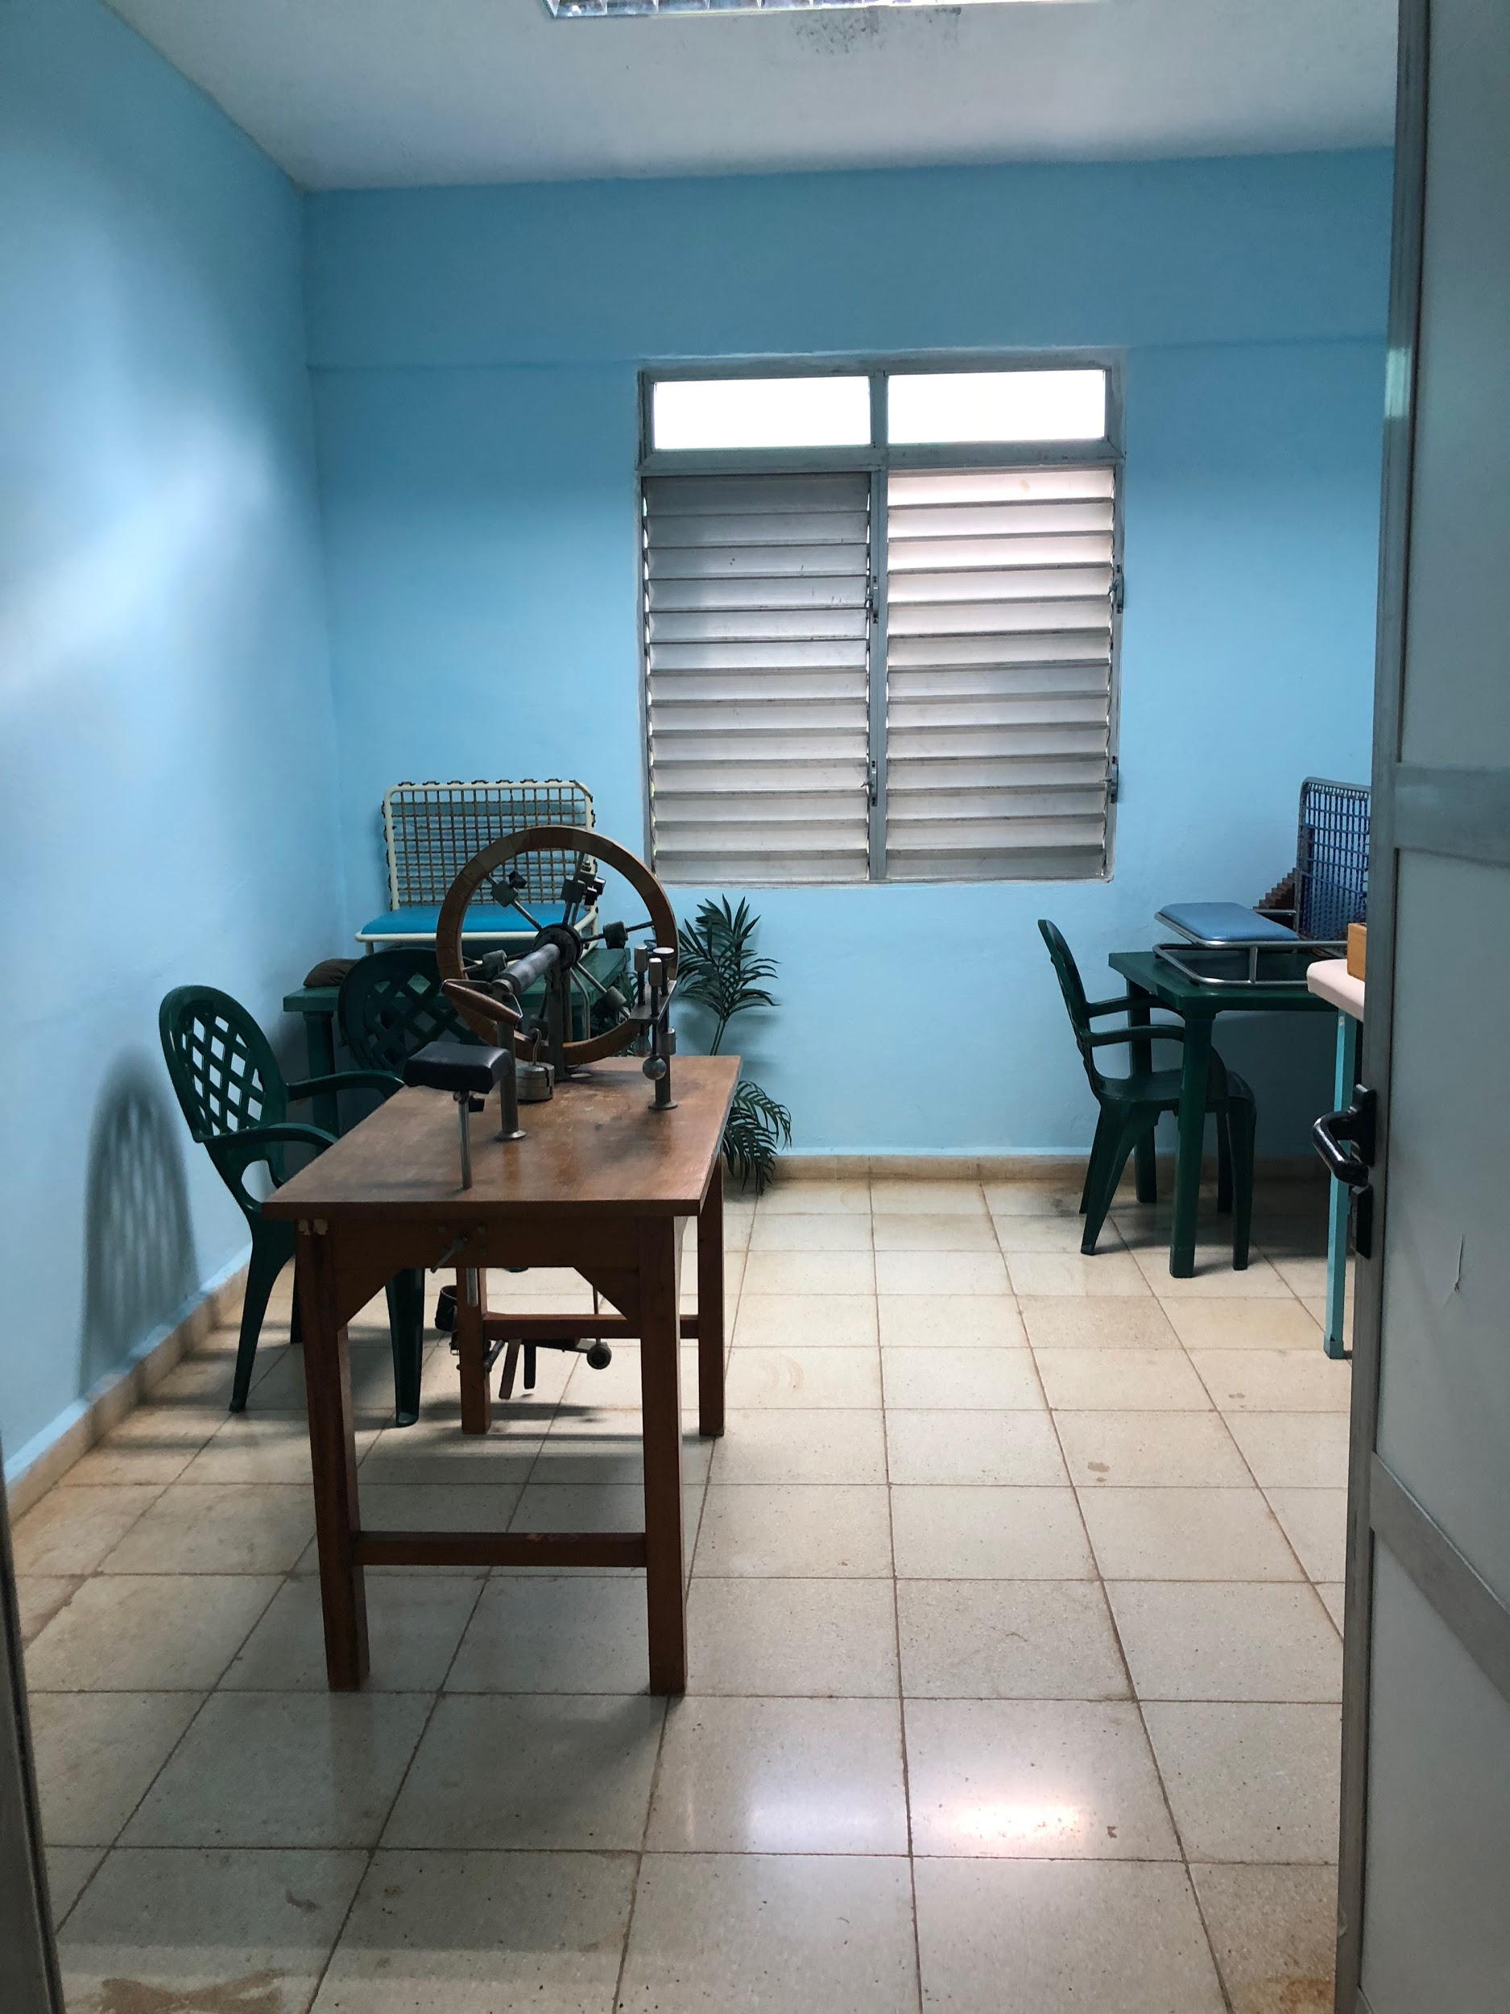
Health Indicators: Cuba vs. United States
Cuba (2017)
  Population: 11,230,142
  Number of births: 114,971
  Infant mortality (per 1,000 live births): 4.0
  Maternal mortality (per 100,000 live births): 38.3
  Life expectancy: 78.4 years
United States (2016)
  Population: 325,719,178
  Number of births: 3,945,875
  Infant mortality (per 1,000 live births): 5.7
  Maternal mortality (per 100,000 live births): 26.4
  Life expectancy: 78.69 years

Slide 3
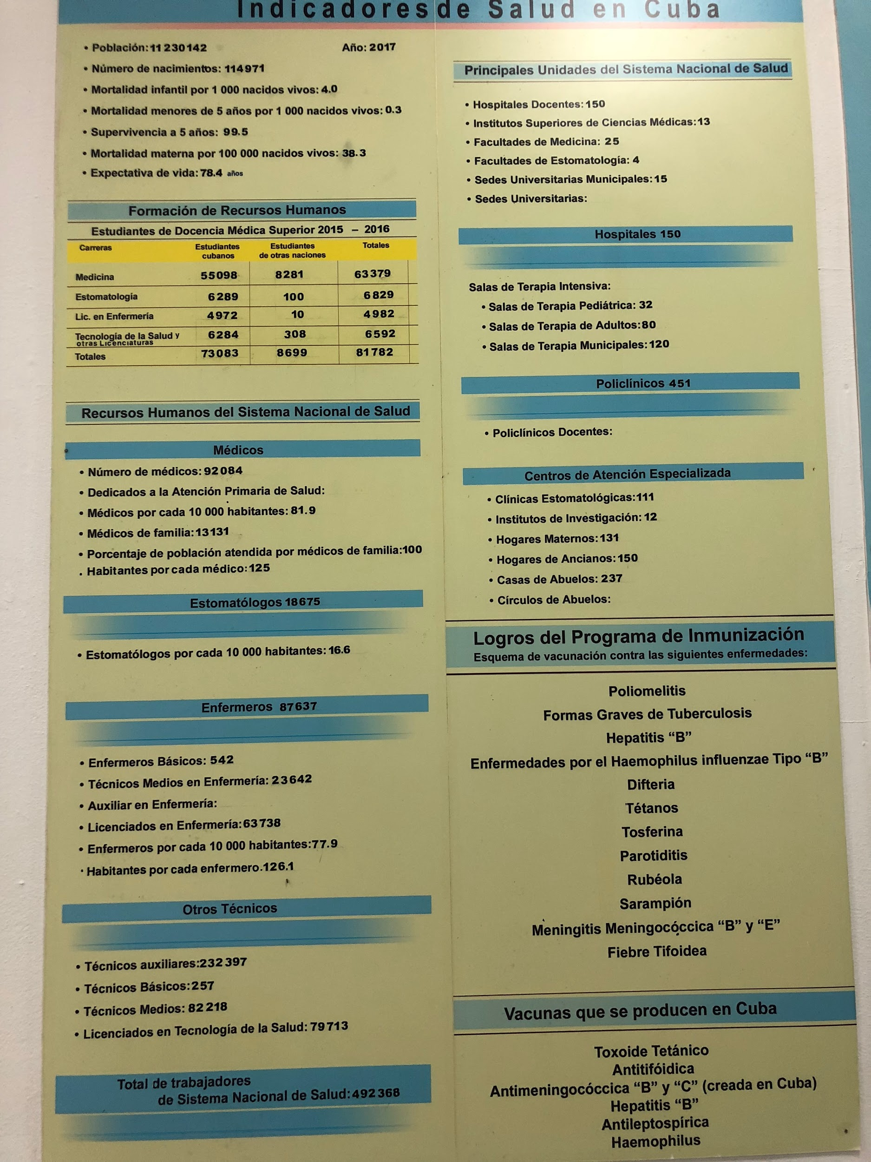

Slide 4
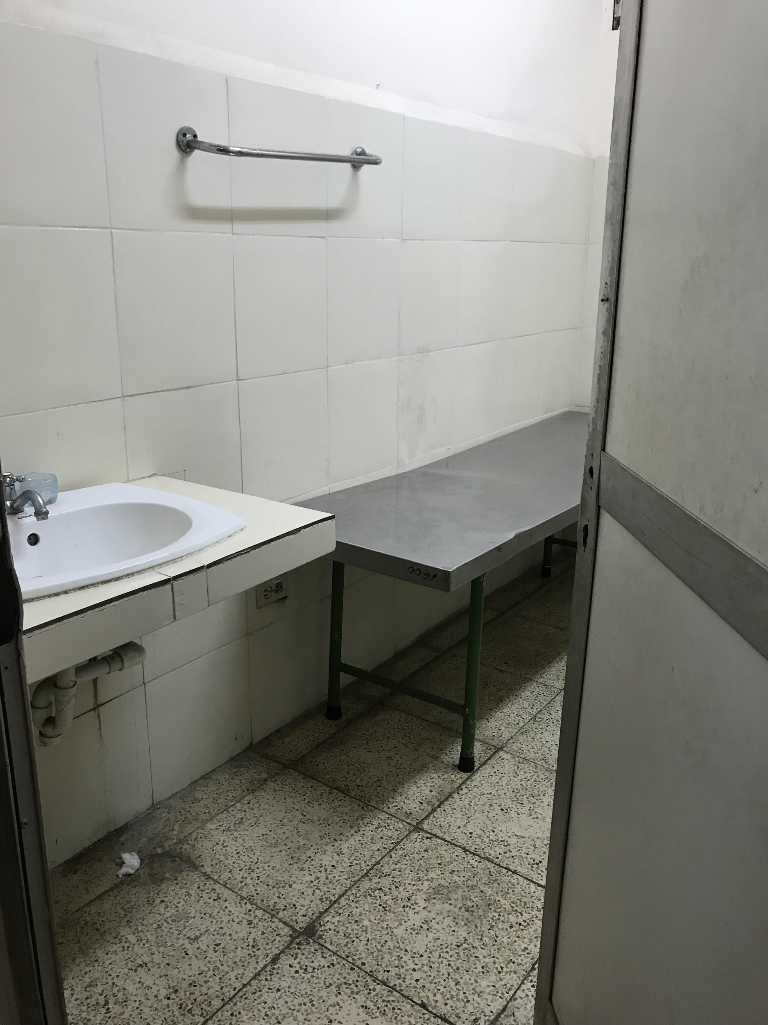
Vaccines Offered in Cuba
Polio
Tuberculosis
Hepatitis B
Haemophilus influenzae type B
Diphtheria
Tetanus
Pertussis
Mumps
Rubella
Measles
Meningococcal meningitis
Typhoid

Slide 5
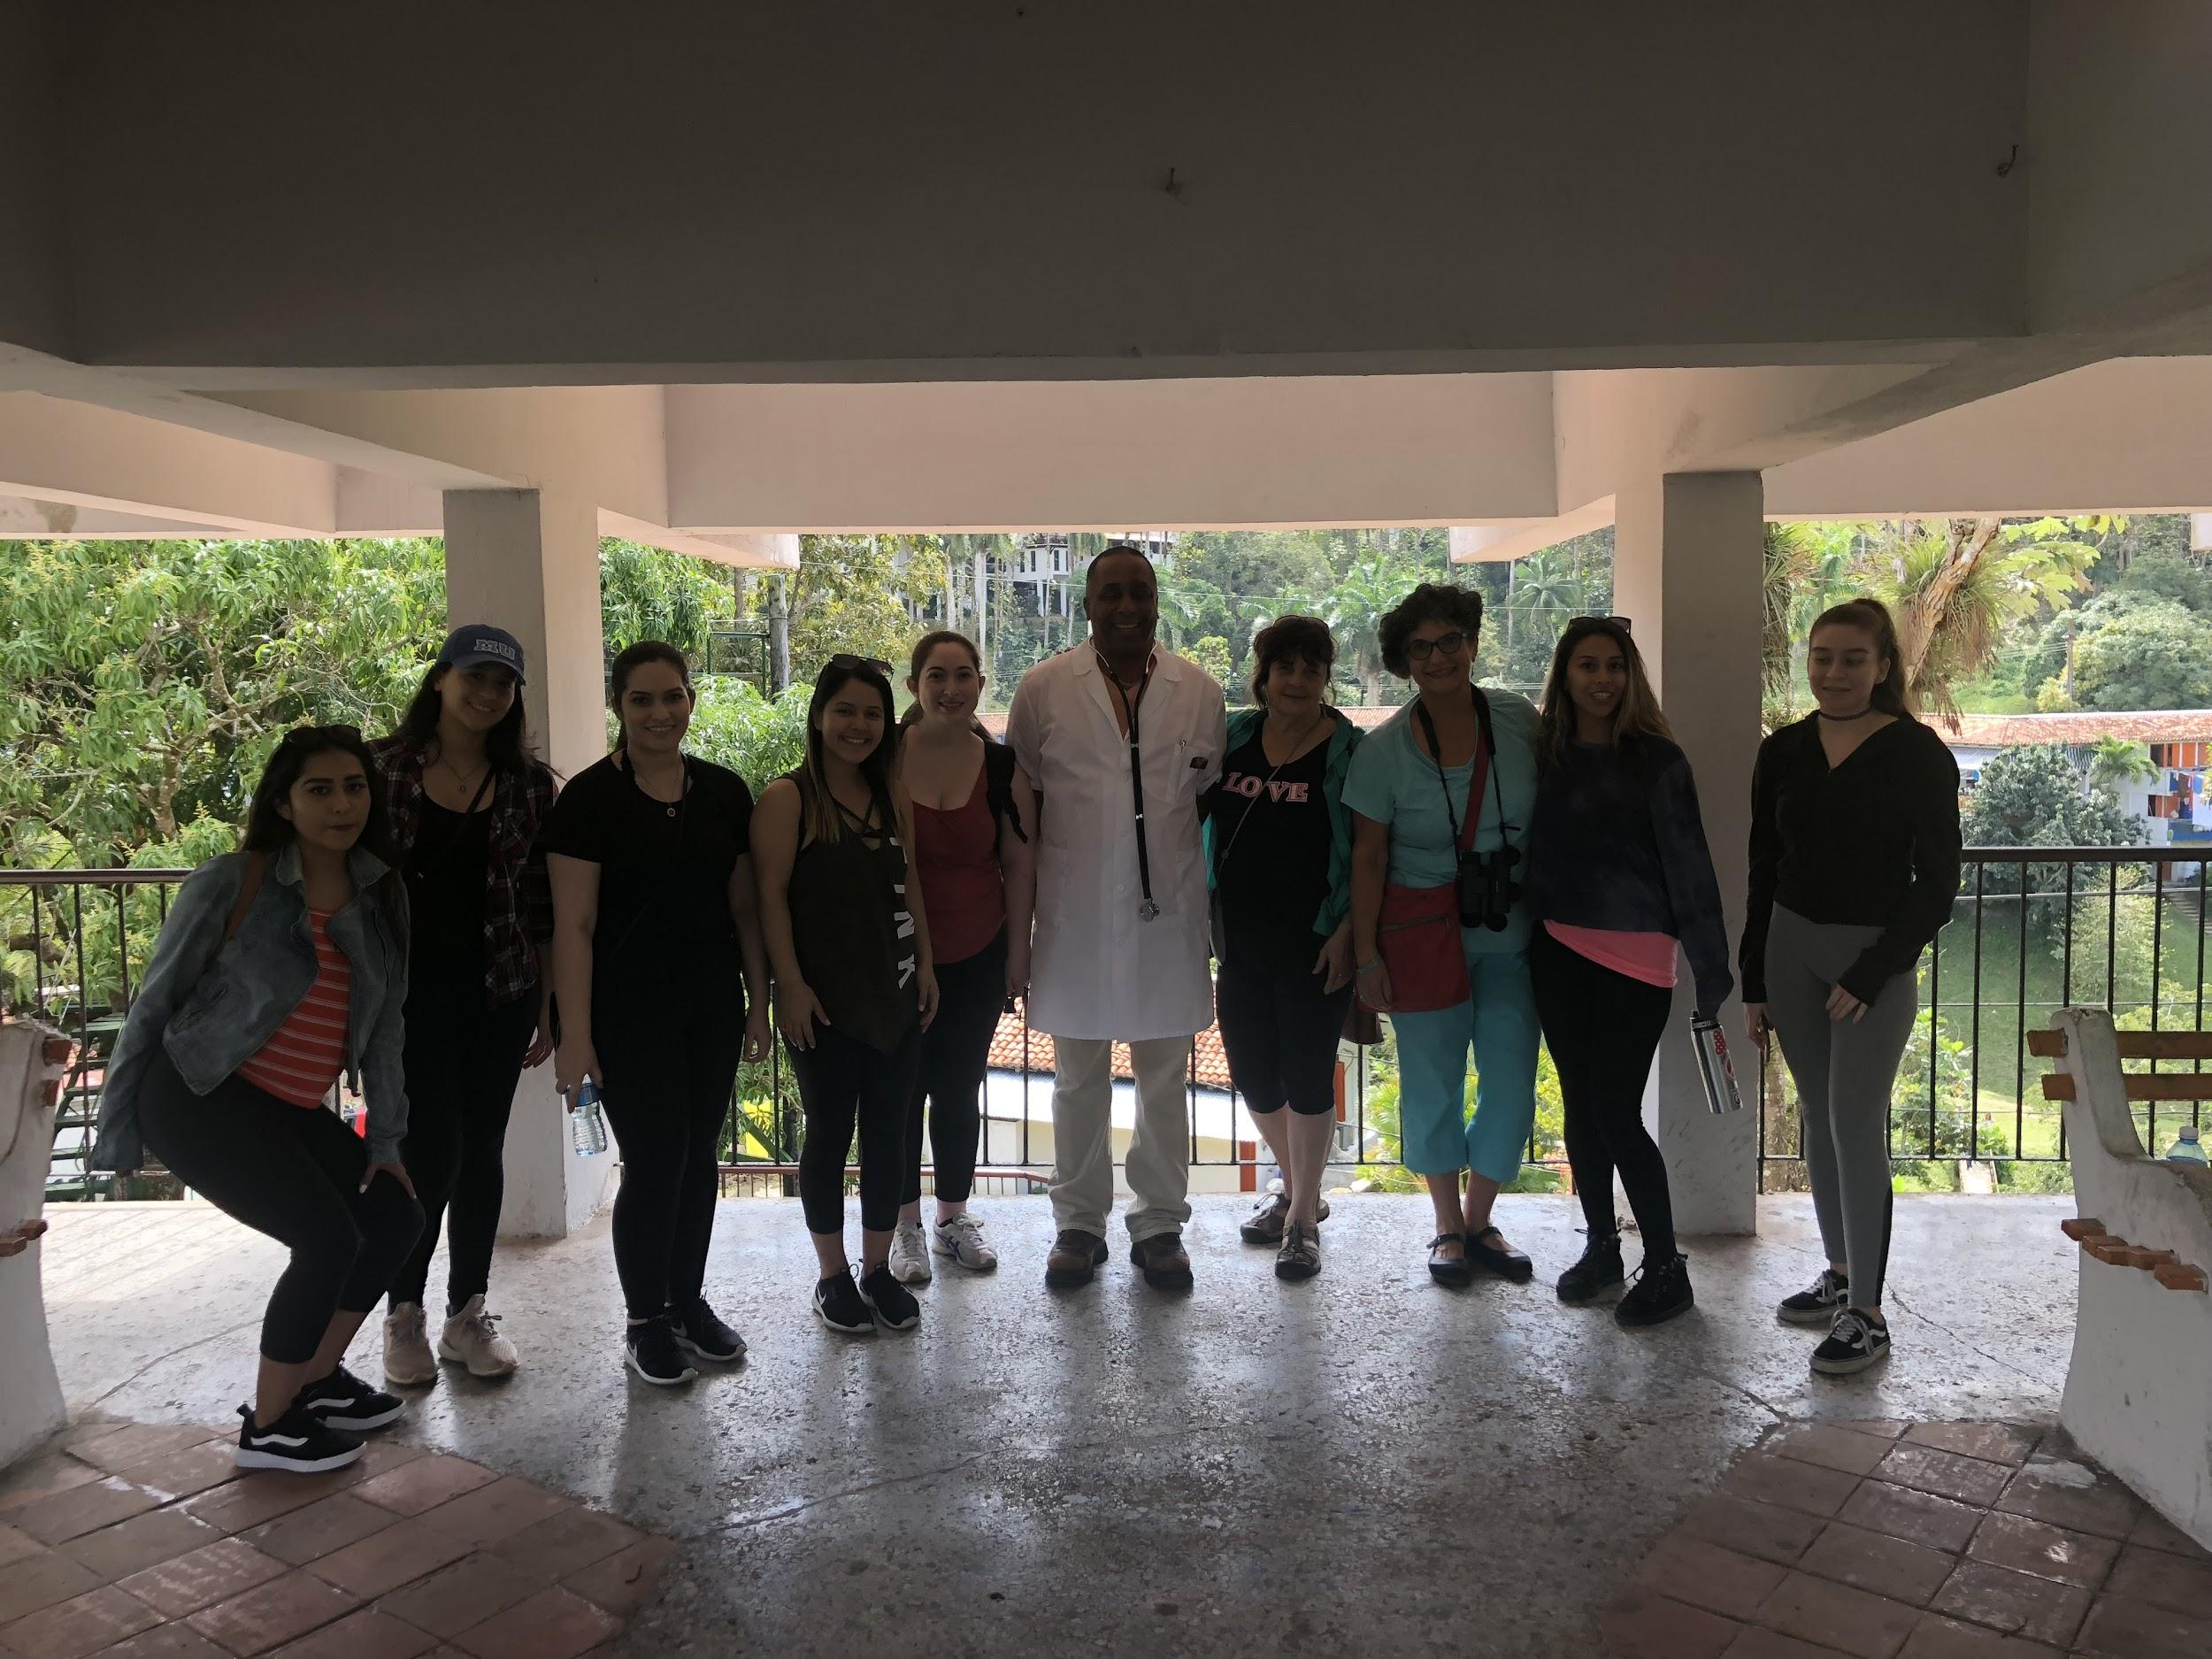
Centralized Healthcare
Social workers, doctors, nurses, and specialists
  In clinics, community clinics and home visits
Universal health care coverage
Primary care/prevention in community clinics “polyclinics”

Slide 6
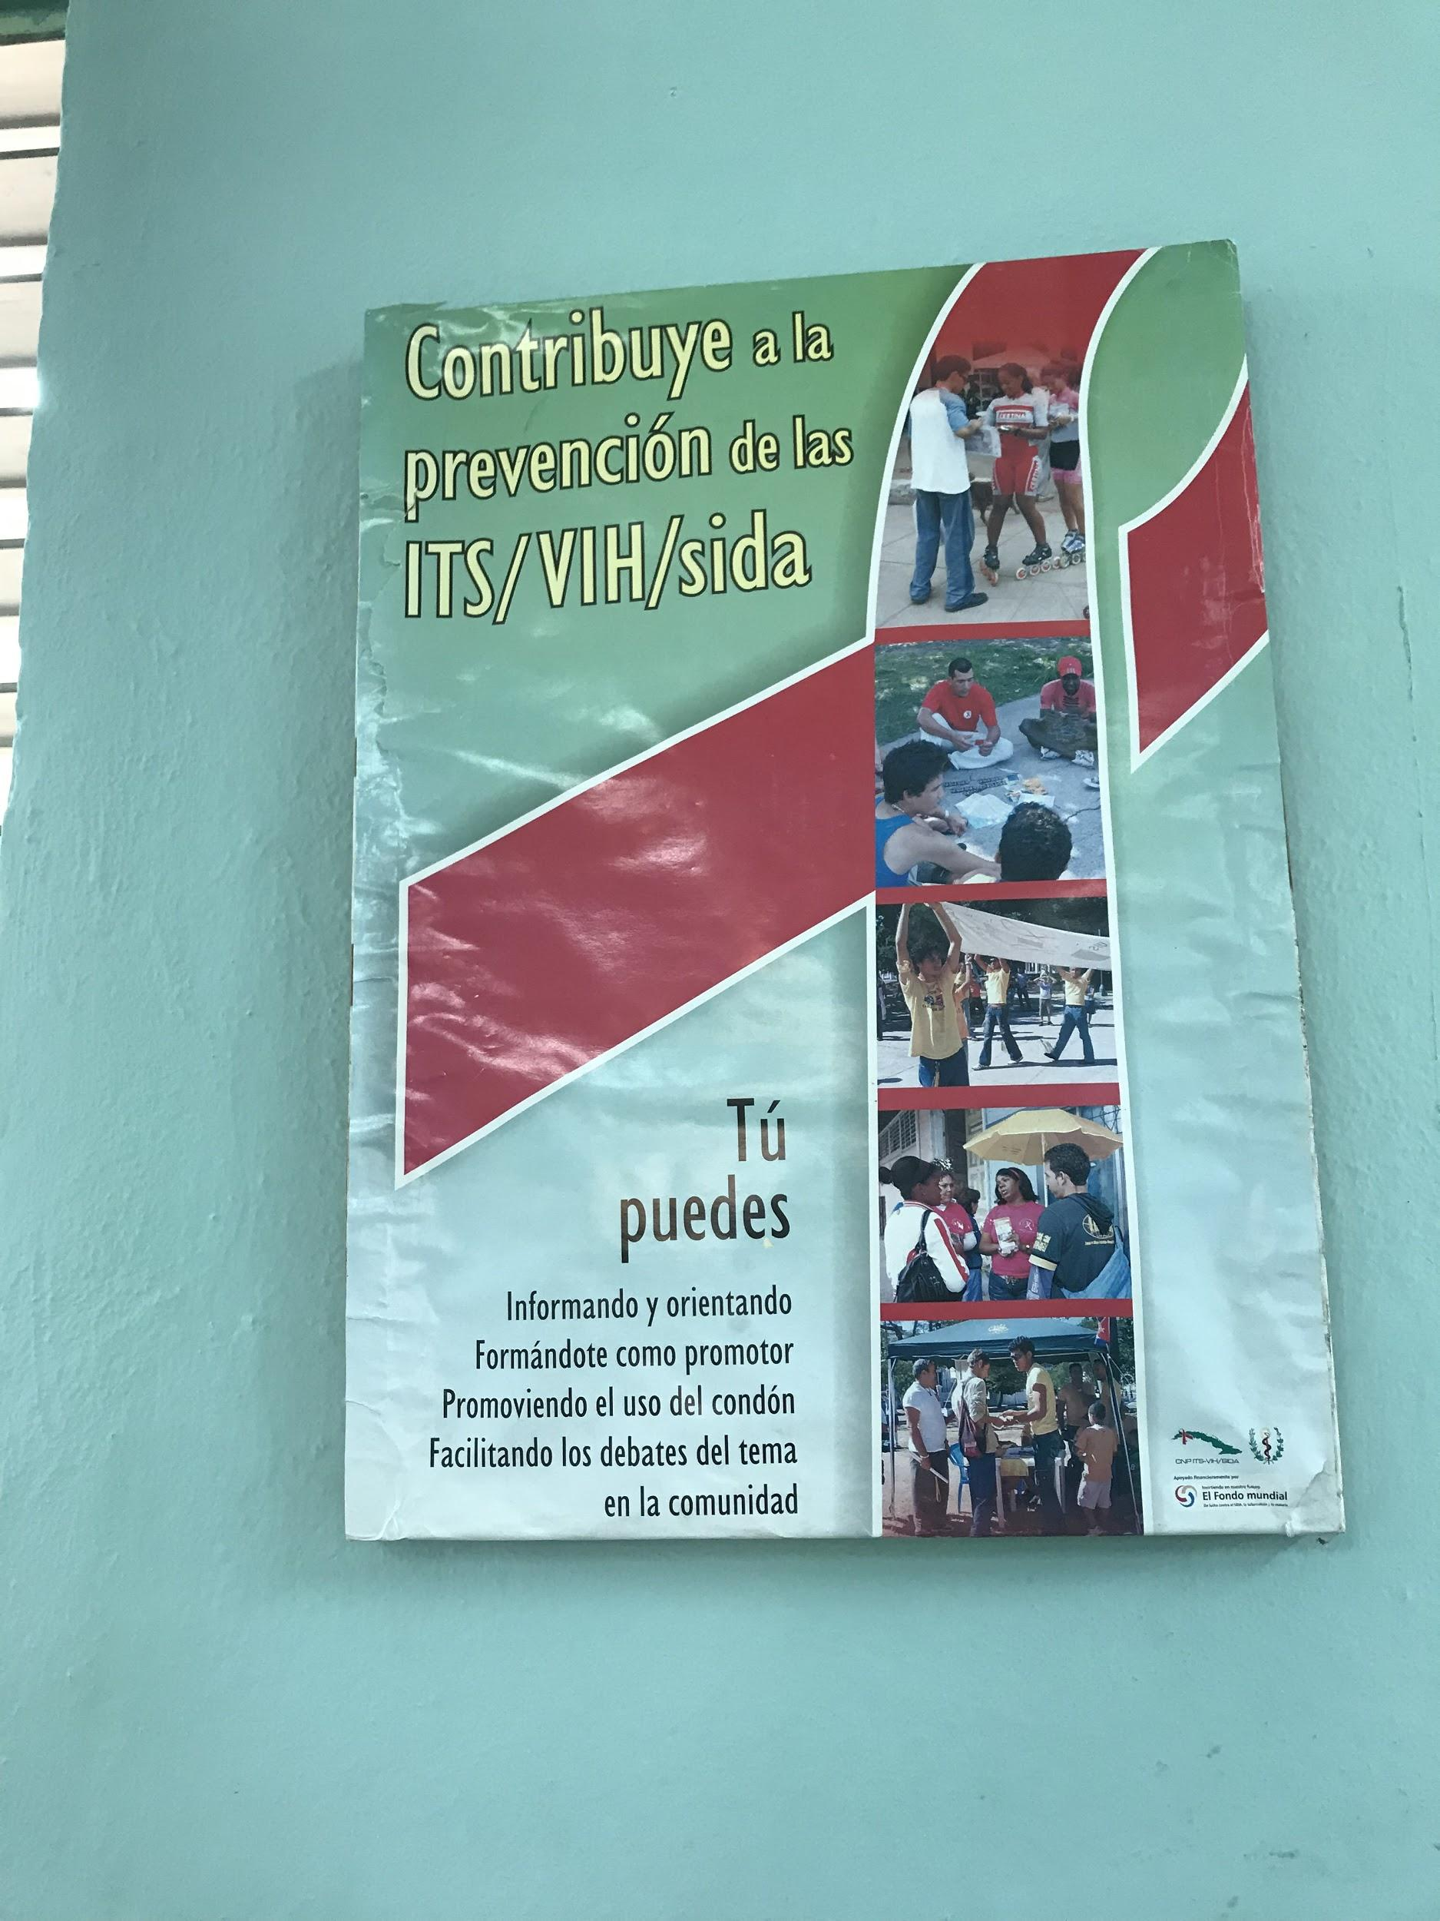
Preventive Medicine
Heavy focus on primary prevention
Prevention is interchangeable with levels of care
Doctors and nurses do outreach and promotion to patients
HIV, syphilis, and maternal care
  No HIV or syphilis transmissions mother to baby
Mandatory vaccinations
  National Immunization Program
Negative side:
  Doctors, nurses, clinics overworked
  Low pay for doctors

Slide 7
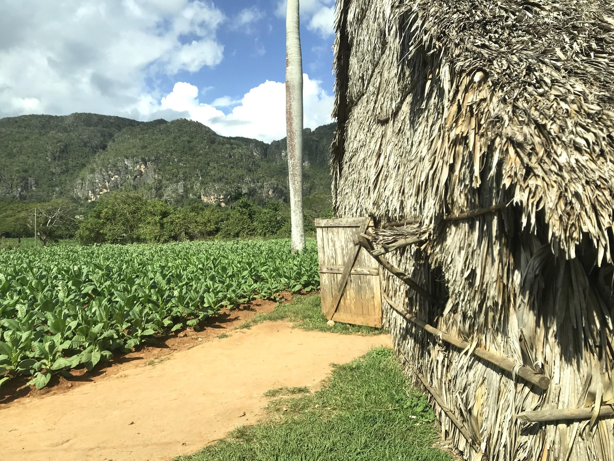
Common Diseases
CANCER
  Breast
  Prostate
  Respiratory for children
Hypertension
Type II Diabetes
Risk factors:
Sugar and fat intake
Sedentary behavior
Lack fruits and vegetables in diet
Tobacco pollution

Slide 8
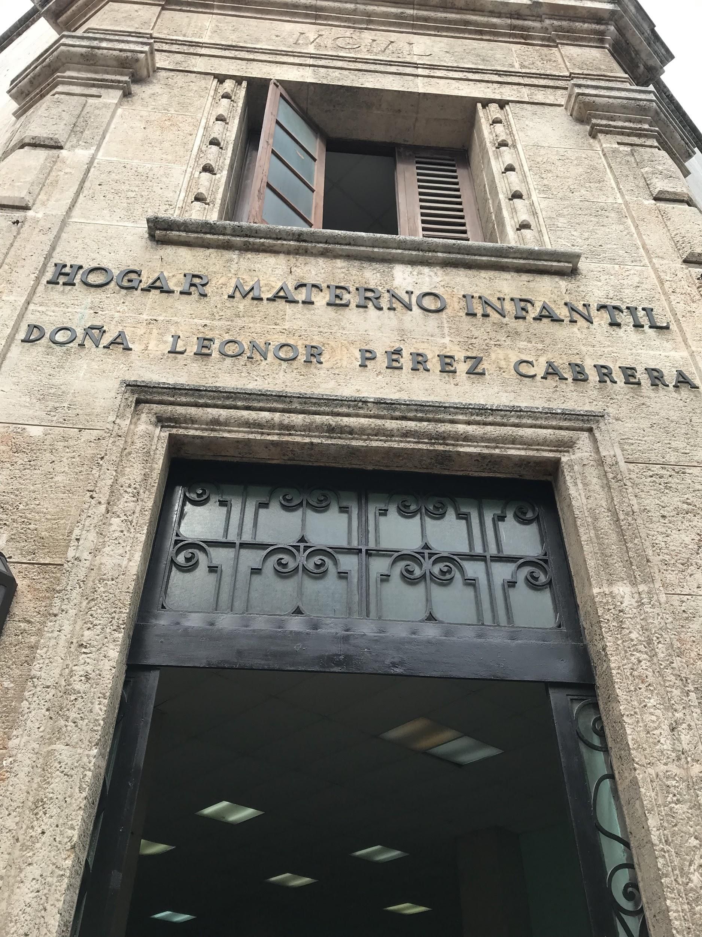
Maternal Care and Infant Mortality Rate (IMR)
Maternity units:
  All high-risk pregnancies
    Mandatory
    Twin births (if 1st labor)
    High blood pressure
    Age
  37 weeks (Las Terrazas)
  As early as 24 weeks (Old Havana)
Infant mortality rate 3.9 in 2018
Doctors held responsible for any complications that occur

Slide 9
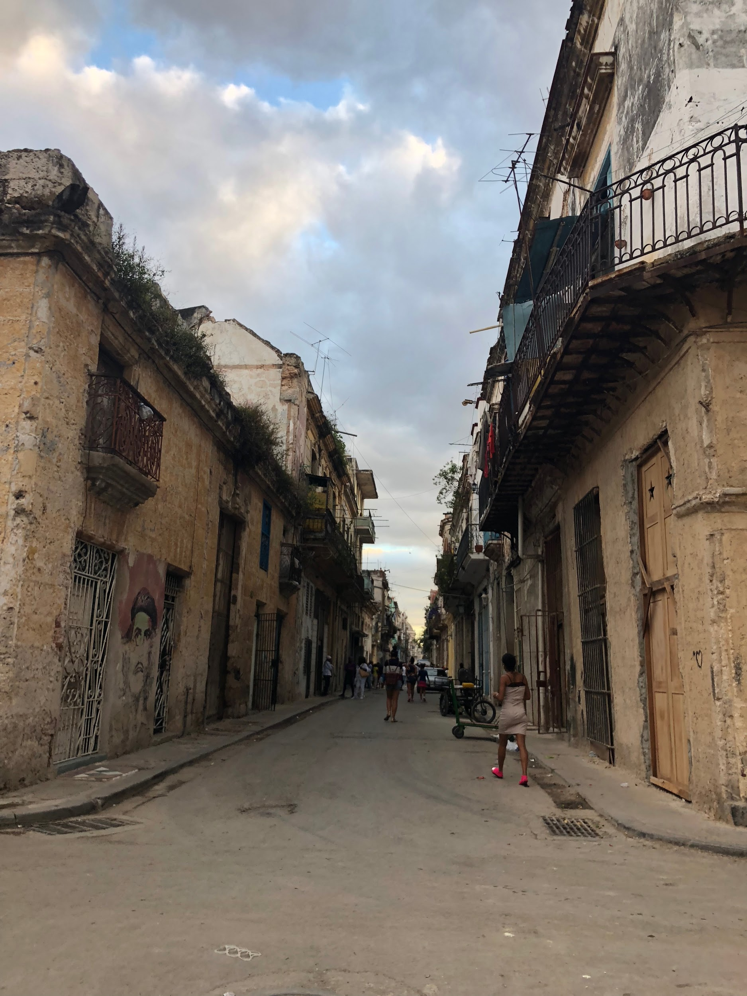
Lack of Resources
Embargo: Access to prototypes and vaccines made only in the U.S.
Technology in clinics and hospitals
  Poor economy
    EX: Economic crisis of 90’s and low birthweight
  Tourism only brings a 30% profit
Hormone treatments: only in HAV
Access to fresh fruits and vegetables
  Production mainly for tourism, hotels, and export
Infrastructure needs improvement
Repair old homes
  ⅓ buildings collapse

Slide 10
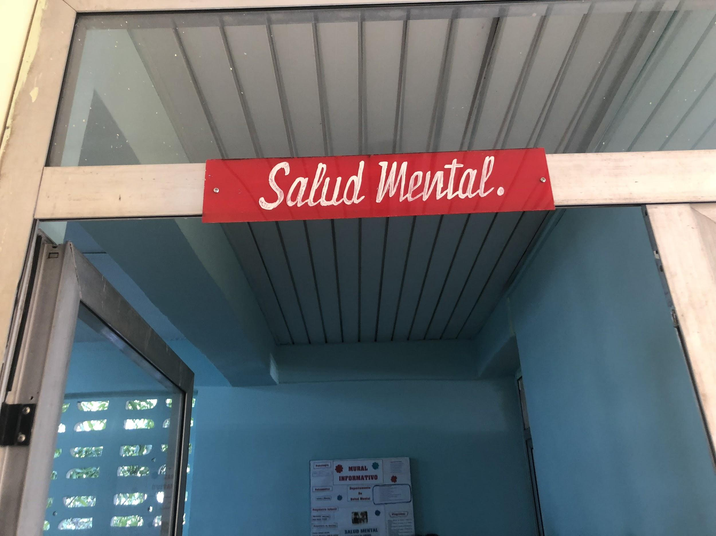
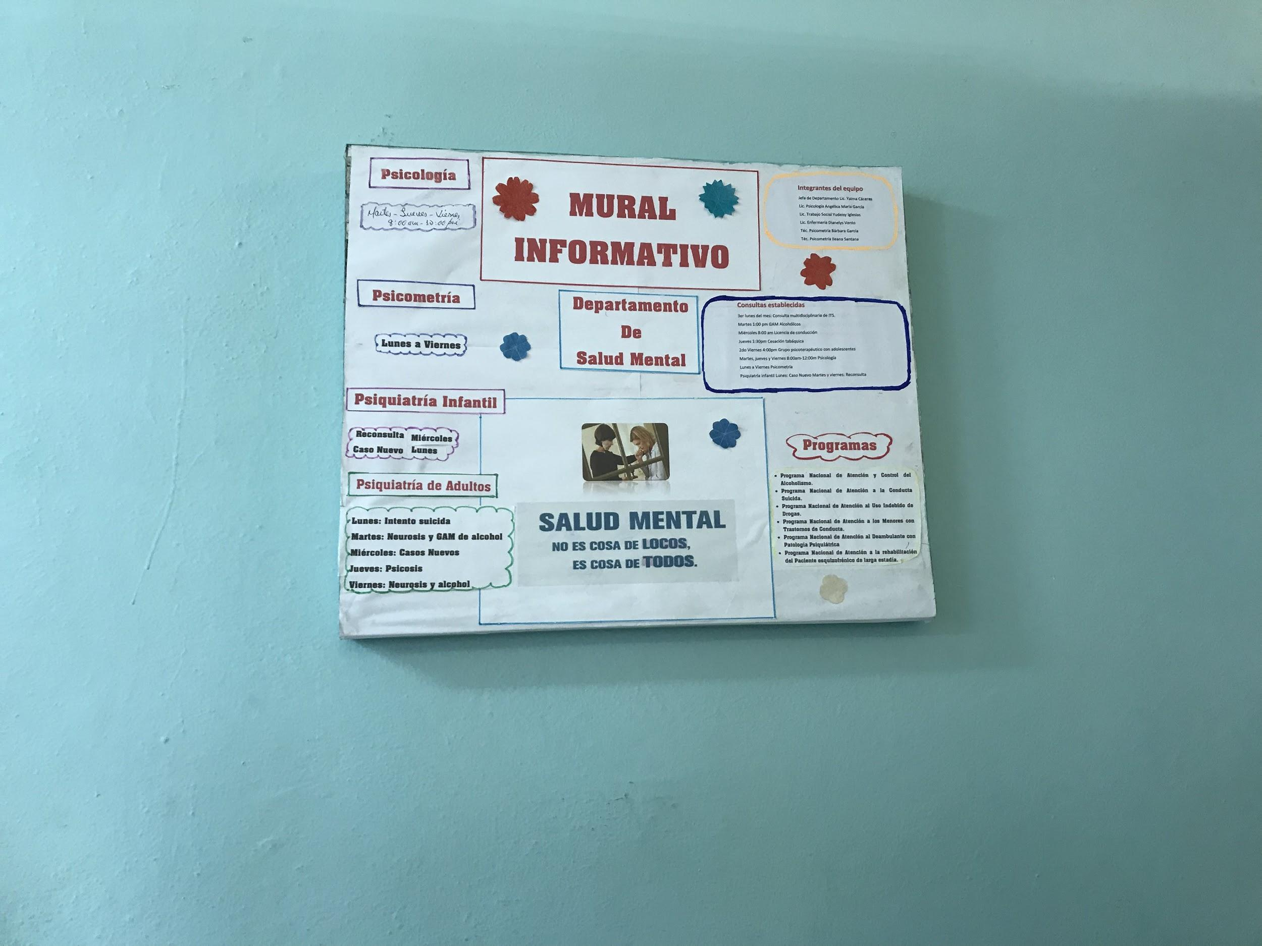
Mental Health
Strongly recommended to bring family members to visits
Holistic approach
Anyone may report things that seem off from an individual to the clinic, but often times done by teachers or family members
Centro Diagnostico works with family members, social workers and doctors to find the best learning approach for children with mental health disorders
Educa Tu Hijo is a program to educate parents going through family crisis

Slide 11
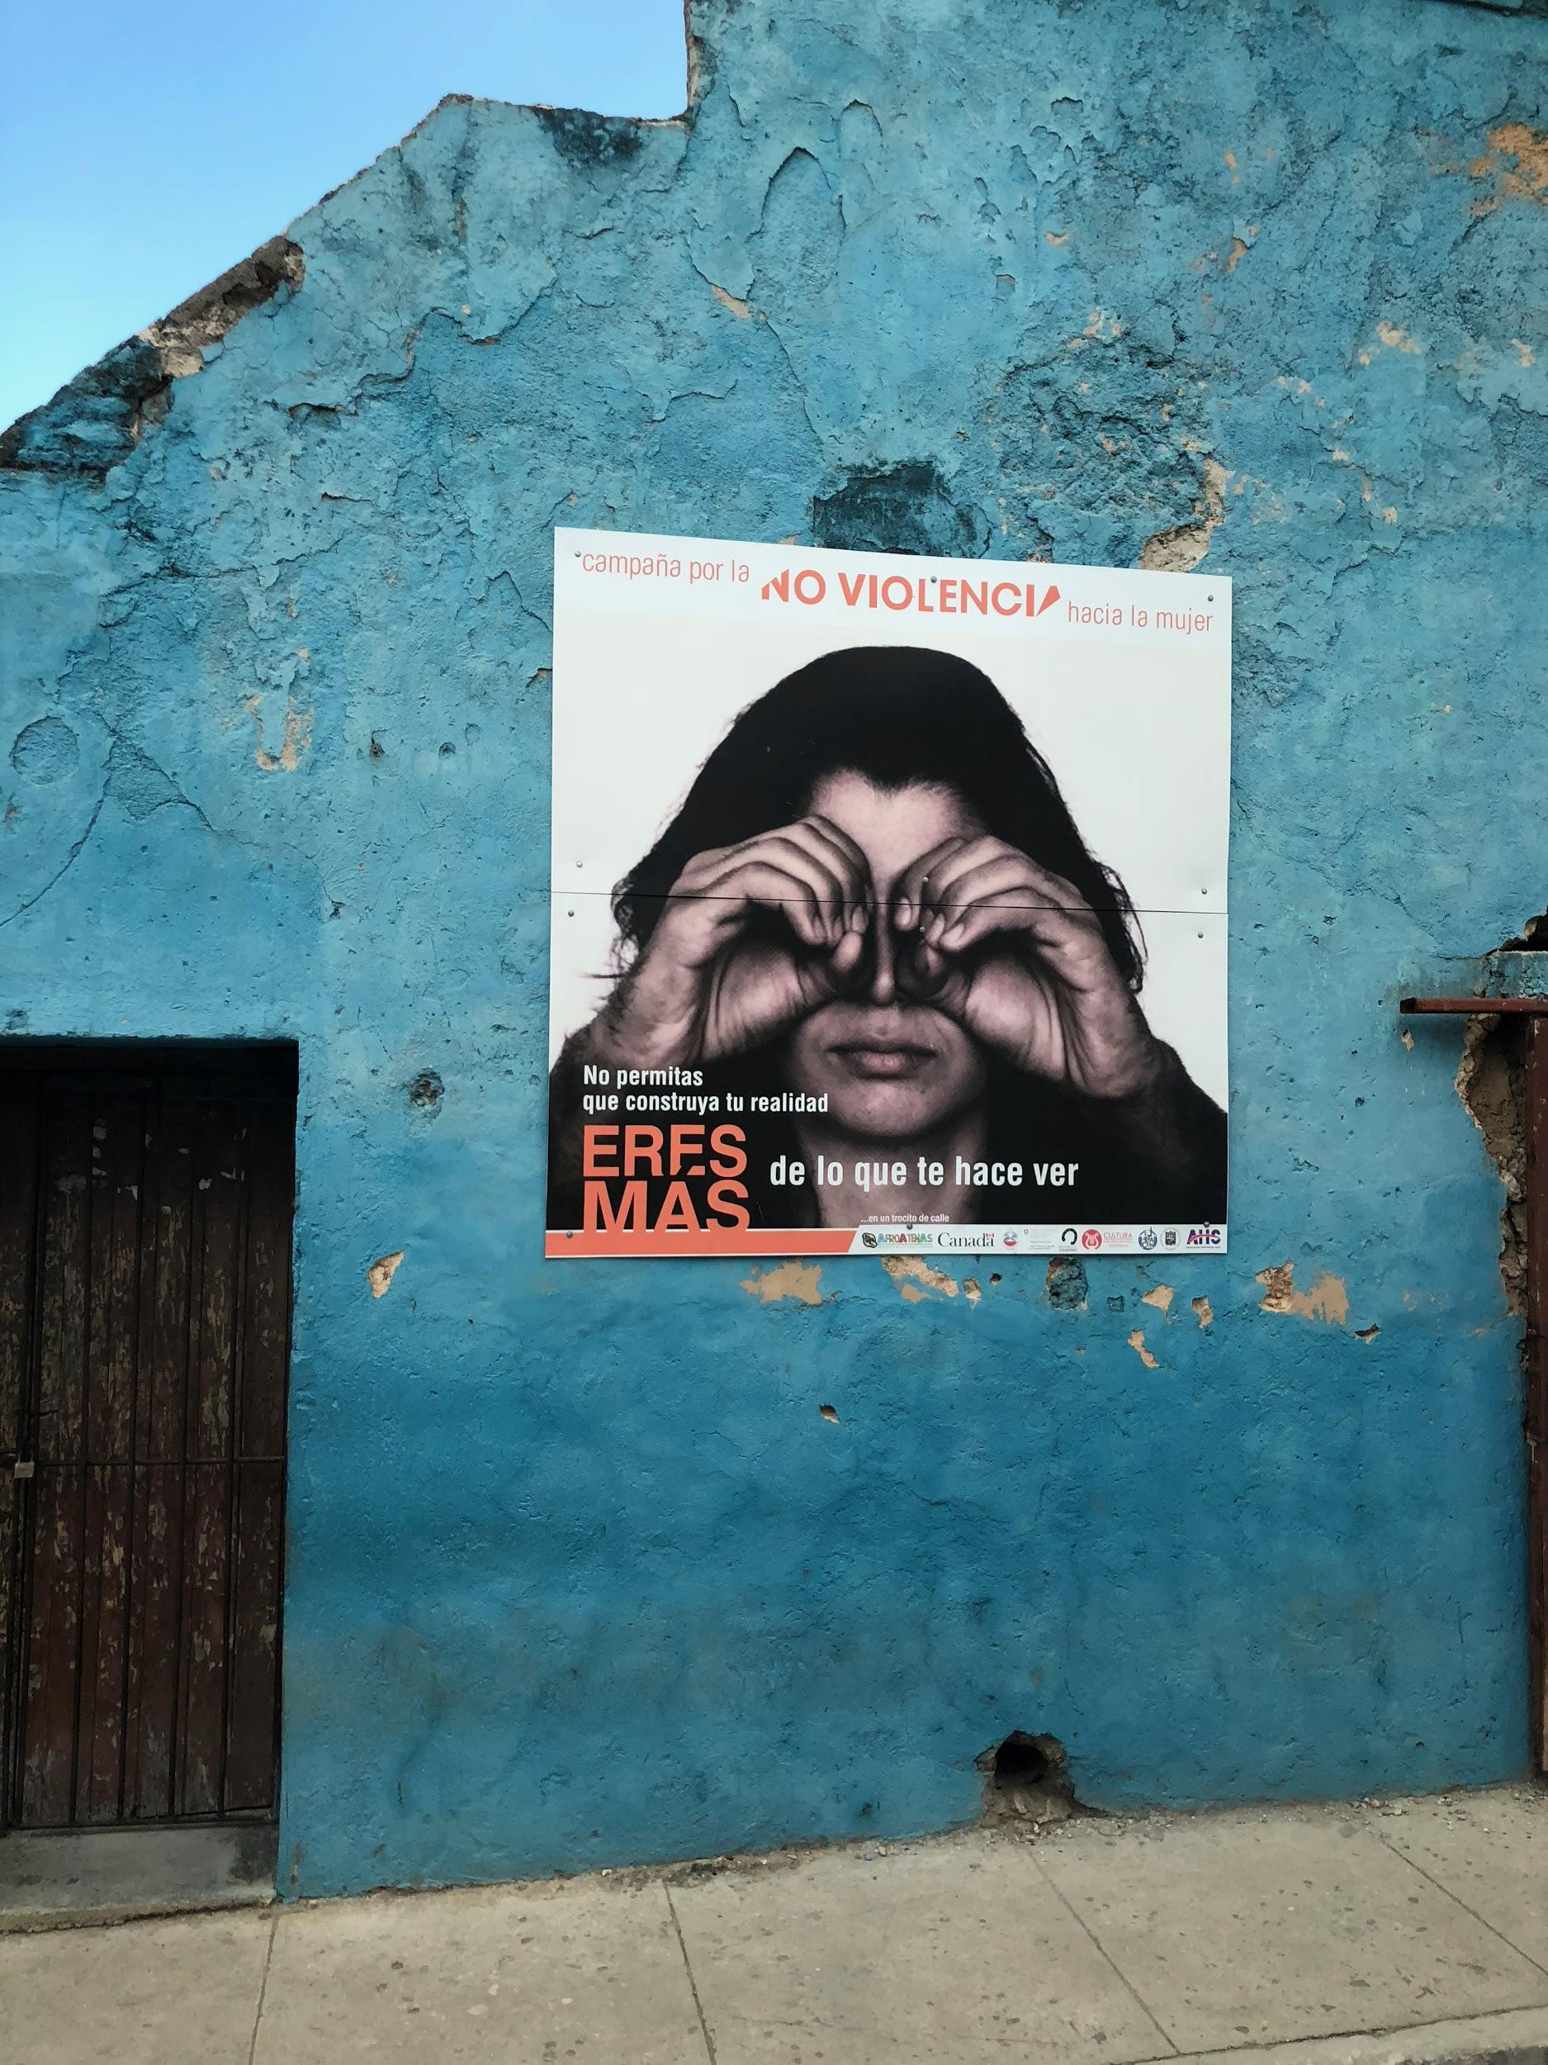
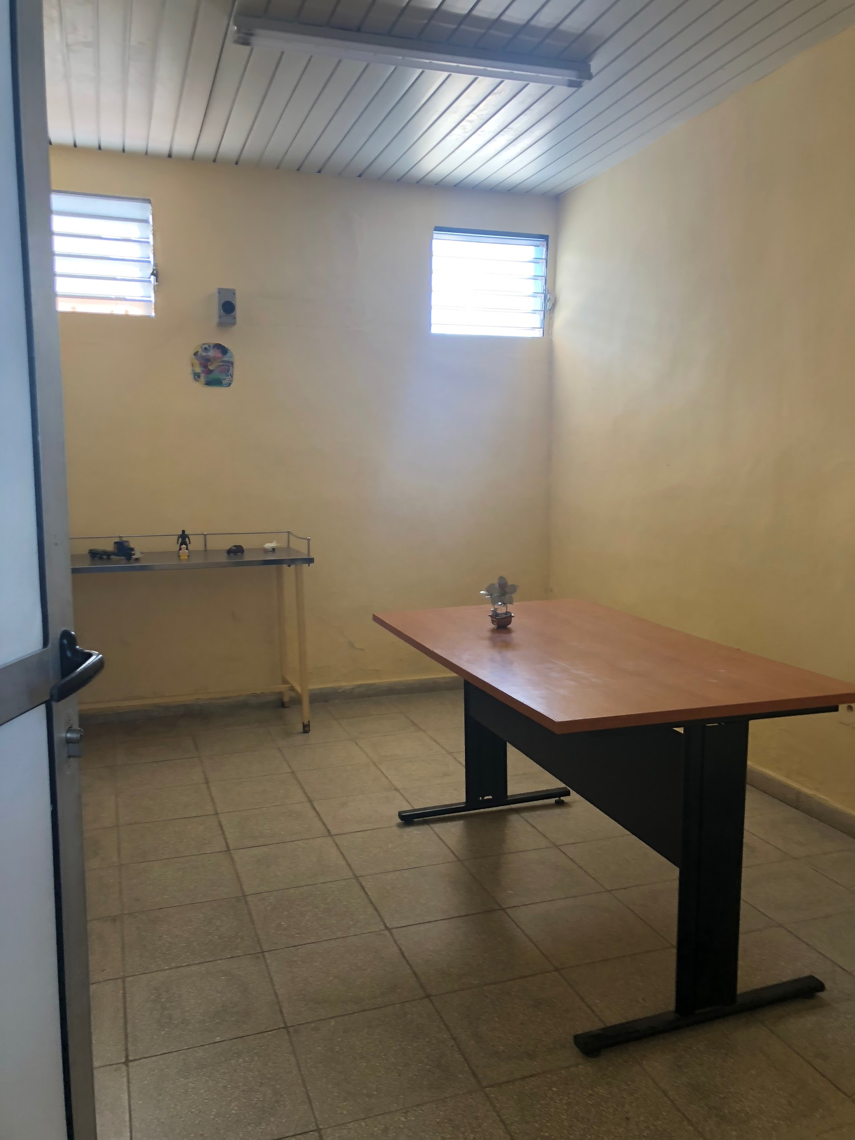

Slide 12
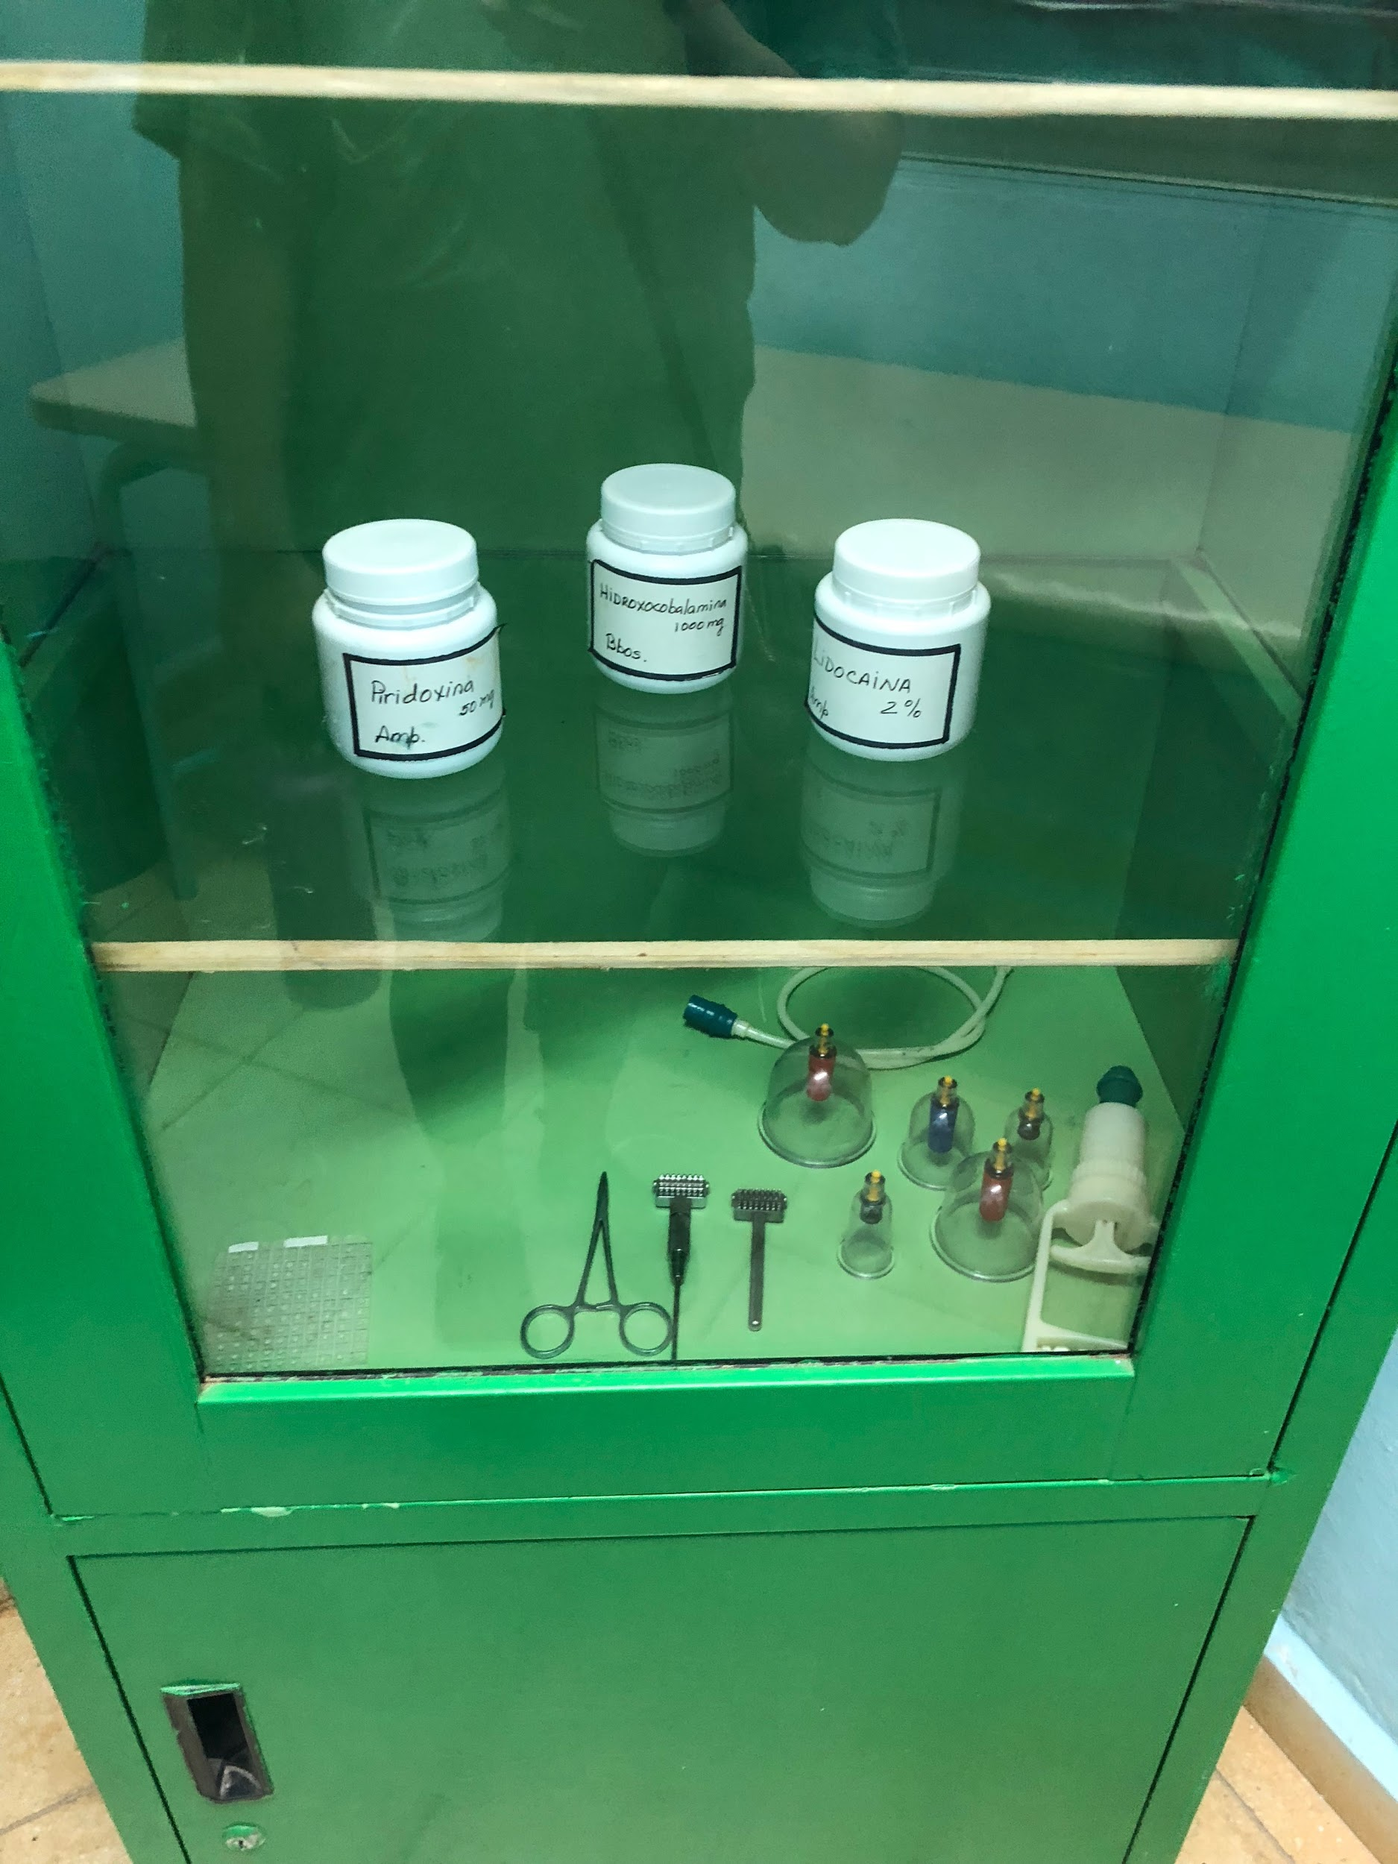
Alternative Medicine
Recommended by a specialist or hospital to this center
Different subdivisions in Policlinico Docente Camilo Cienfuegos:
  Physical therapy, occupational therapy, rehabilitation, gymnasium, nutrition
Minimal use of prescription drugs/ over the counter drugs.
Healing and practices based on Asian natural and traditional medicine, also use:
  Medicinal plants, acupuncture, and Tai Chi
Belief the use of natural ways of healing is both safer and the recovery is faster.

Slide 13
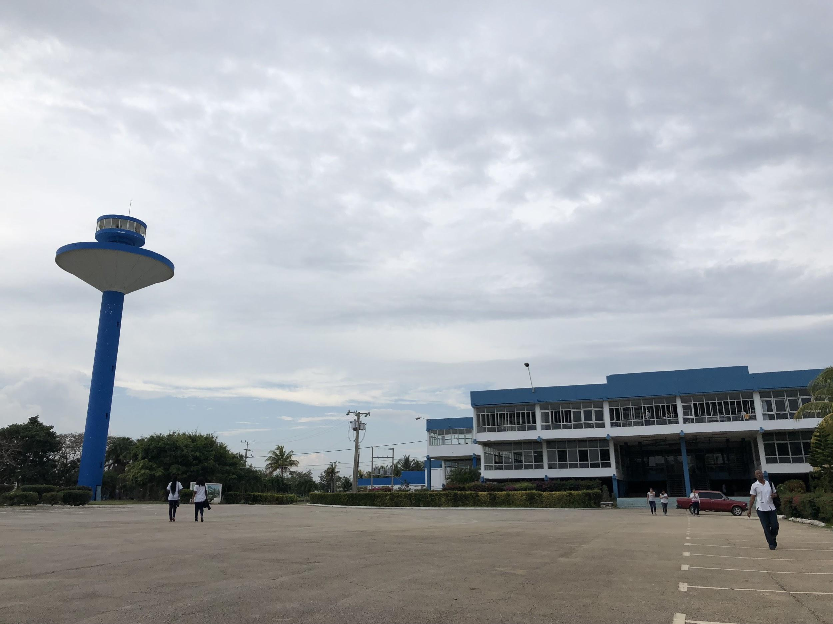
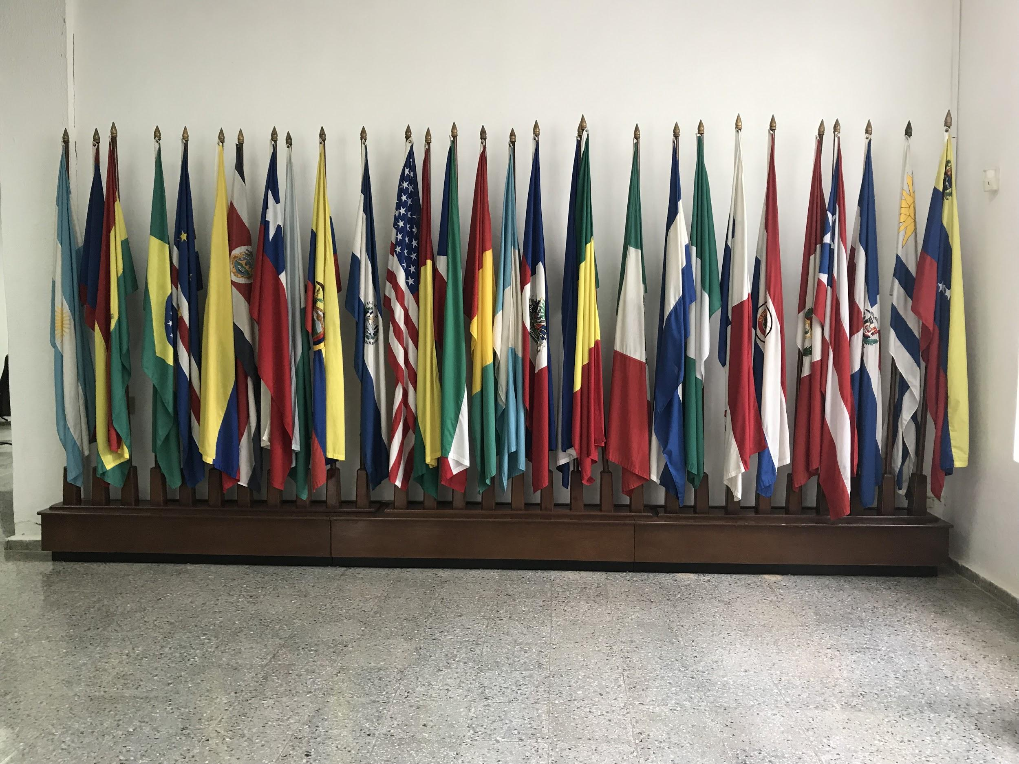
Escuela Latinoamericana de Medicina (ELAM)
The Latin American School of Medicine
For students who cannot afford medical school in their home country
Give out scholarships every year for students
Everything is paid for with the scholarship (housing, uniform, food, etc.)
Have to be under the age of 25 years old
Students are selected in their own country
All classes are taught in Spanish
  First 6 months are spent learning Spanish
6 years of medical school in total
The idea is for students to go back to their home countries to practice medicine there and work with underserved communities

Slide 14
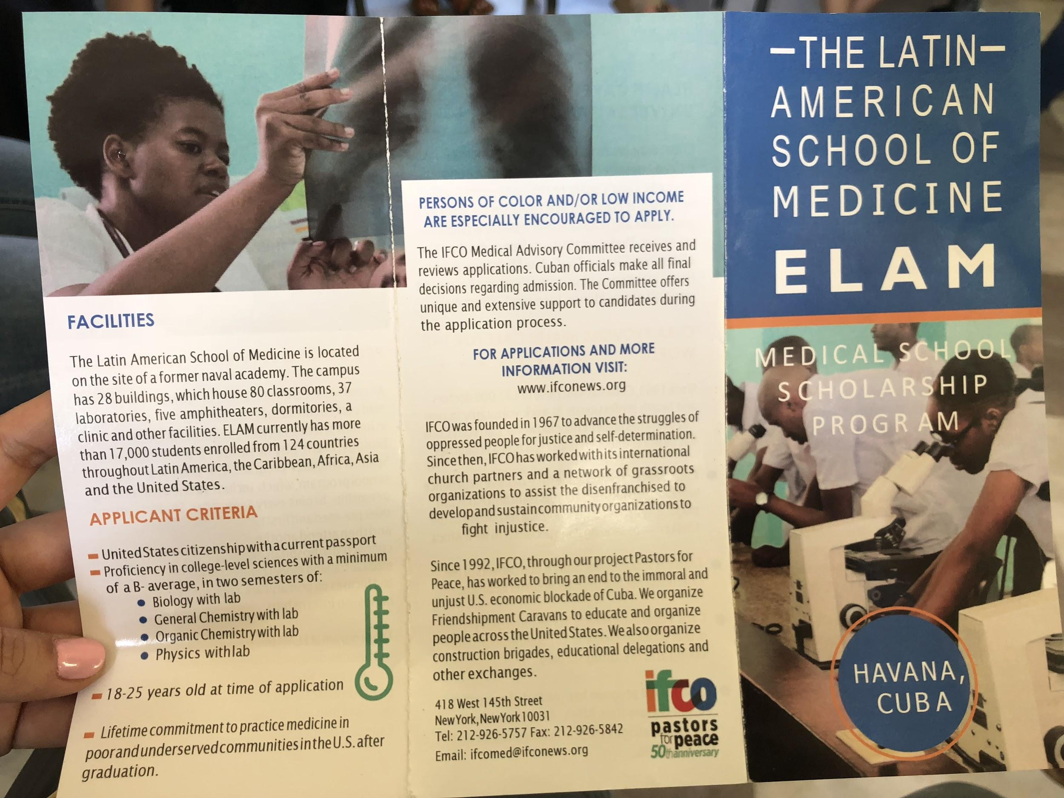

Slide 15

CENESEX
Centro Nacional de Educación Sexual
Politics and government played a big role in sexuality in Cuba
Cuba was very homophobic in the 60s and 70s
Mariela Castro, Fidel Castro’s niece, is responsible for the shift in gay rights
In the last 15 years, transgender population has been able to go to school, while no longer being discriminated against
CENESEX strives to help individuals go through transition surgery, provide hormones and contraceptives
Notes:
In the last 15 years transgender population have been able to go to school and the CENESEX helps talk to the schools to allow them to understand why the individual needs to dress a certain way
They help them go through the transition surgery and get on the waiting list about 456 on the list and it might start back up at 2019
They have done 50 surgeries since 1986
They have hormones available for them as well

Slide 16

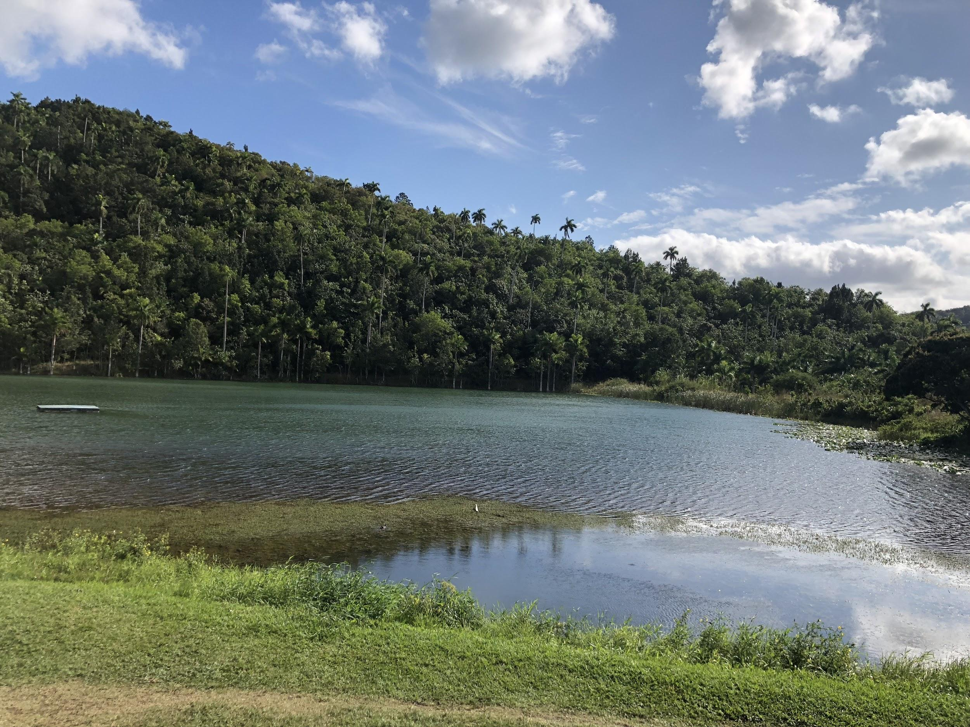
References
Centers for Disease Control and Prevention. (2017). FastStats - Births and natality. Retrieved from https://www.cdc.gov/nchs/fastats/births.htm
GBD 2015 Maternal Mortality Collaborators (2016). Global, regional, and national levels of maternal mortality, 1990-2015: a systematic analysis for the Global Burden of Disease Study 2015. Lancet (London, England), 388(10053), 1775-1812.
The World Bank. (2018). United States. Retrieved from https://data.worldbank.org/country/united-states

Slide 17
